Slide 1
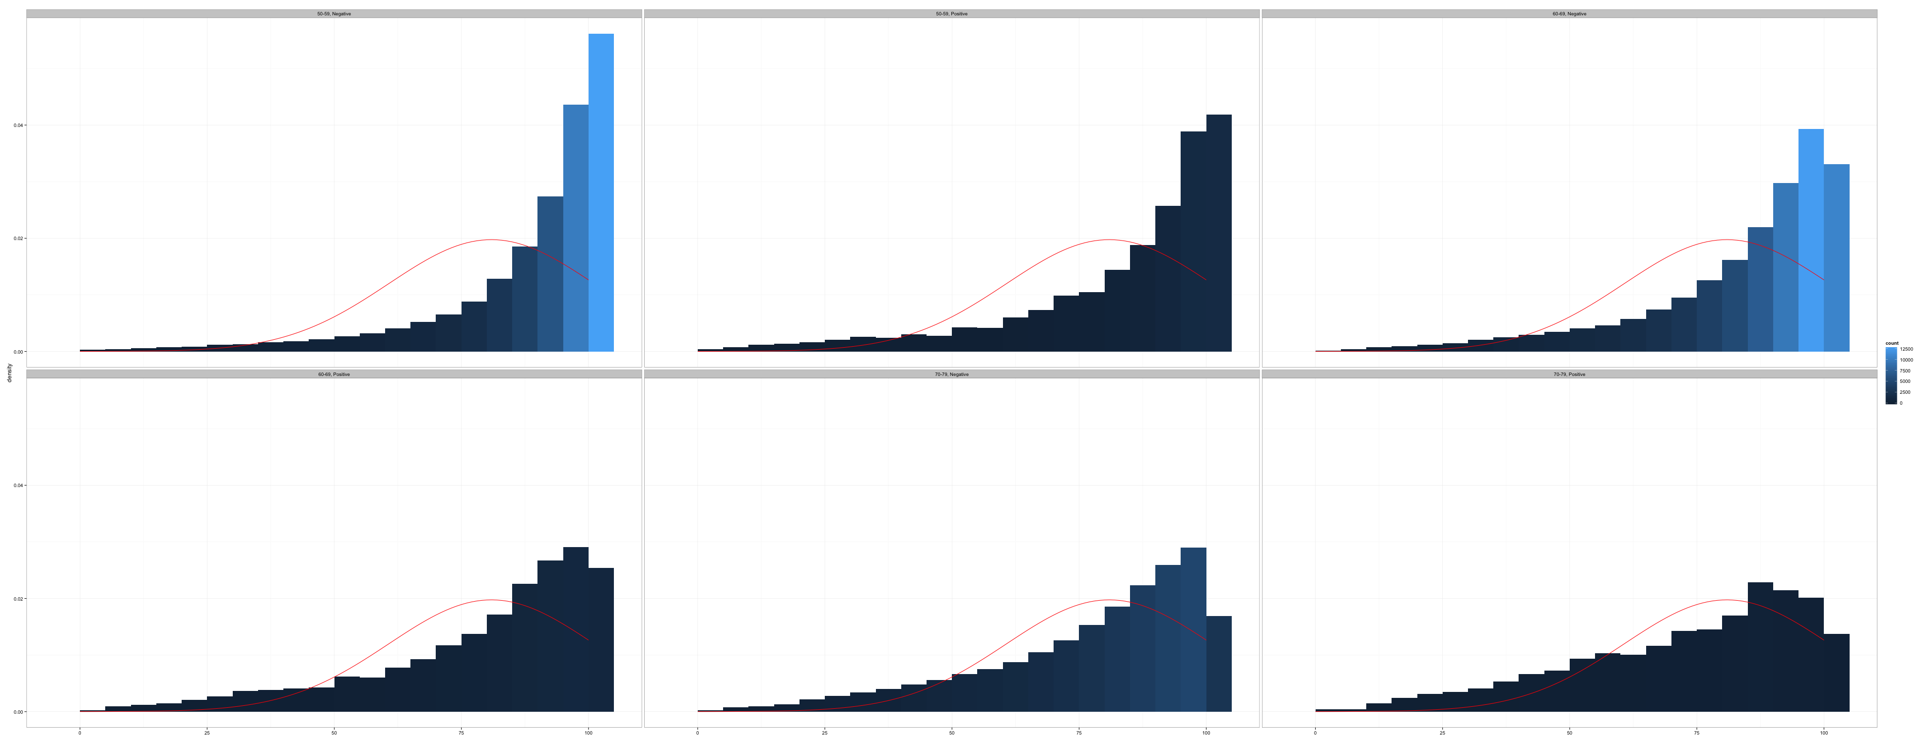
Skip Patterns: Data Checking
Introduction to Data Management and Statistical Computing

Slide 2
Demonsration
Data checking
Notes:
The final step is to do a quick data check to make sure we didn’t miss anything.

Slide 3
proc freq data = new_ds;
tables hadpap2 * lastpap2 pap5 / nopercent norow nocol missing;
run;
Notes:
Again, there are many ways you could do a data check. I’m using proc freq to do mine.

Slide 4
proc freq data = new_ds;
tables hadpap2 * lastpap2 pap5 / nopercent norow nocol missing;
run;
Notes:
Specifically, in my tables statement I’m asking SAS to give me a contingency table with possible responses for hadpap2 in the rows by possible responses for lastpap2 in the columns. I’m also asking for a separate one-way frequency table for for my new variable pap5. I want to compare the values in pap5 with the values in hadpap2 and lastpap2.

Slide 5
proc freq data = new_ds;
tables hadpap2 * lastpap2 pap5 / nopercent norow nocol missing;
run;
Notes:
Finally, to keep the table cleaner, I’ve added the nopercent, norow, and nocol options. These suppress the output of the overall percent, row percent, and column percent respectively. I’ve also added the missing option, which tells SAS to display missing values in our contingency table in the same way it displays any other category. For this particular data check, the missing option is necessary.

Slide 6
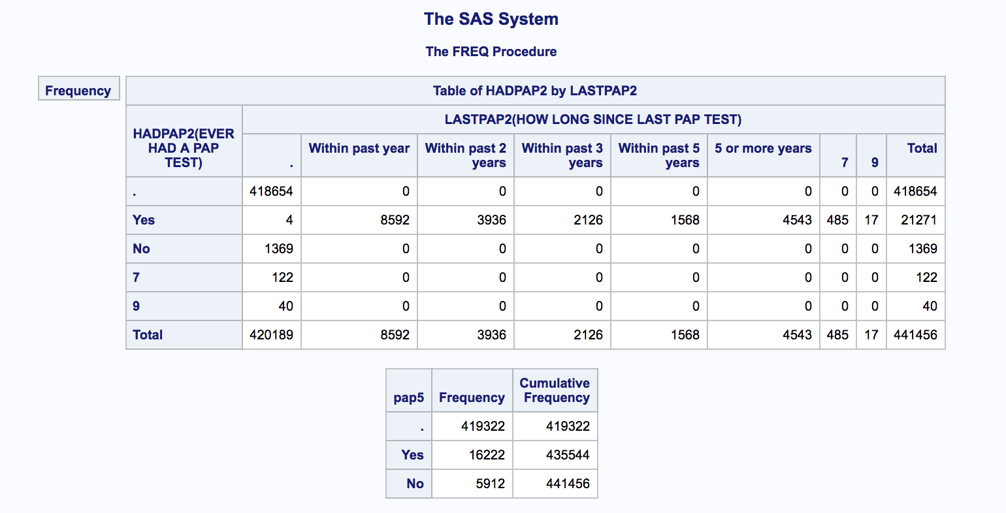
Notes:
And, this is the report we get when we run proc freq.

Slide 7
Notes:
It tells us that 16,222 participants said that they have ever had a pap test, and also said that they’ve had one in the past 5 years.

Slide 8
Notes:
Which is the same number we got in our new variable. So far, so good.

Slide 9
Notes:
Next, we can see that 4,543 participants said that they have had a pap test, but they had it 5 or more years ago.

Slide 10
Notes:
We can also see that 1,369 participants said they have never had a pap test – and therefore, have also not have a pap test in the past five years.

Slide 11
Notes:
1,369 plus 4,543 equals 5,912, which is the answer we got.

Slide 12
Notes:
Finally, let’s take a look at who we haven’t classified as a yes or a no in our new variable.

Slide 13
Notes:
Well, we can ignore all the zeros. There are no participants there. We can also ignore the marginal totals.

Slide 14
Notes:
These participants didn’t answer either question, so we have no information regarding their pap test history.

Slide 15
Notes:
These four participants said that they’ve had a pap test, but they didn’t tell us how long ago they had it.

Slide 16
Notes:
The same is true for these 502 participants. Unfortunately, we don’t know if their pap test was 10 days ago or 10 years ago. Therefore, the only value we can give them for pap5 is missing.

Slide 17
Notes:
Finally, these 162 participants didn’t tell us whether they’ve ever had a pap test or not. We certainly can’t say if they’ve had one in the past 5 years or not. Therefore, the only value we can give them for pap5 is missing.

Slide 18
Notes:
And again, these numbers all add up to exactly the answer we got. We can now feel confident that we appropriately accounted for the skip pattern.

Slide 19
What proportion of women that participated in the 2015 BRFSS have had a pap test in the past 5 years?
proc freq data = new_ds;
tables pap5;
run;
Notes:
Now we can run a simple one-way frequency table to answer our research question. What proportion of women that participated in the 2015 BRFSS have had a pap test in the past 5 years?

Slide 20
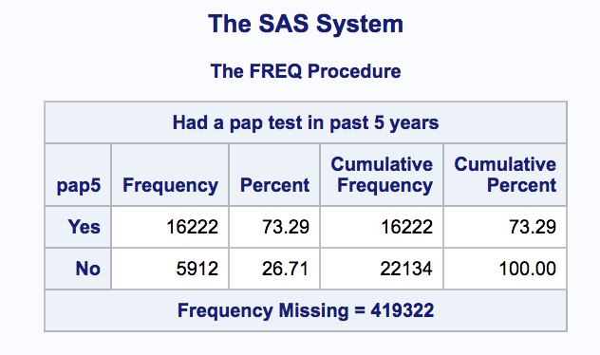
What proportion of women that participated in the 2015 BRFSS have had a pap test in the past 5 years?
Notes:
The answer is 73% of the women who participated in the 2015 BRFSS had a pap test in the past 5 years.

Slide 21
Skip Pattern Recap
Identify
Notes:
Before we wrap up, let’s quickly recap what we learned in this video. You’re first task is just to identify the skip patterns.

Slide 22
Skip Pattern Recap
Identify
Decide if it needs to be accounted for
Question
Context
Notes:
Then you must decide if you need to do anything to account for the skip pattern. I suggested you do this by thinking about your research question, and the other information available to you in the context of the entire data set.

Slide 23
Skip Pattern Recap
Identify
Decide if it needs to be accounted for
Question
Context
Data management
Notes:
Once you’ve decided that you need to account for the skip pattern, you can do so using the conditional processing techniques you already know.

Slide 24
Skip Pattern Recap
Identify
Decide if it needs to be accounted for
Question
Context
Data management
Data checks
Notes:
Finally, it’s always a good idea to do data checks. I’ve been working with data for many years, and I still catch myself making mistakes all the time during my data checks. So, please don’t forget to do them. And with that, we’ve concluded our discussion on skip patterns.

